Slide 1
Financial Impacts of Mental Health
By: Madison Lincks and Kiara McLaurin

Slide 2
Overview
This is a paid research survey gathered from Kaggle.com to explore the linkage between mental illness and unemployment. The National Association on Mental Illnesses has conducted multiple surveys verifying the high unemployment rate among those with mental illness.
This information gathered between the linkage between mental health and unemployment furthered our need for knowledge based on post secondary education as well with its linkage to mental health. We wanted to show linkage between both education and unemployment.

Slide 3
3 Questions
Does having mental health illnesses impact your ability to further your education?
Is mental health more predominant in certain post secondary education levels
Does having mental health illnesses impact your household income?

Slide 4
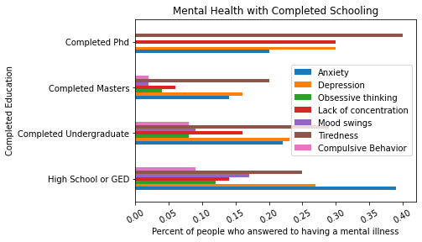
Percent of counted survey questions about having a mental health illness and their post secondary education status

Slide 5
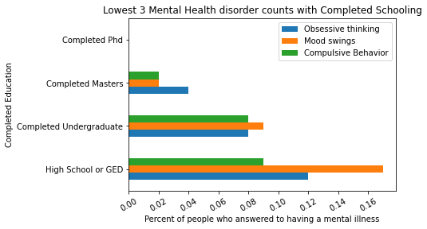
Follow-up data found within the lowest 3 mental health illnesses

Slide 6
Analysis
We found Mental health to be present in all education levels, but what we found to be interesting is why were there less mental illnesses accounted for people with a Masters degree vs any other completed education level.
The 3 mental illnesses with the lowest counts were obsessive thinking, mood swings, and compulsive behavior. We found people who completed a PhD claimed to have none of these illnesses when asked. However they were prominent in high school and undergraduate completion.
Another interesting find was that anxiety was the highest recorded mental illness in high school completion but it was the lowest in Phd completion.

Slide 7
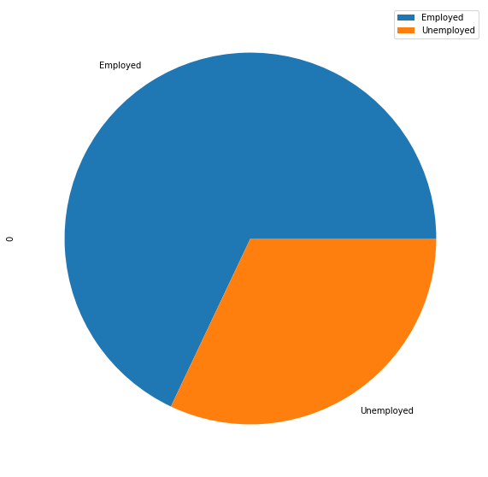
Survey results of their employment status

Slide 8
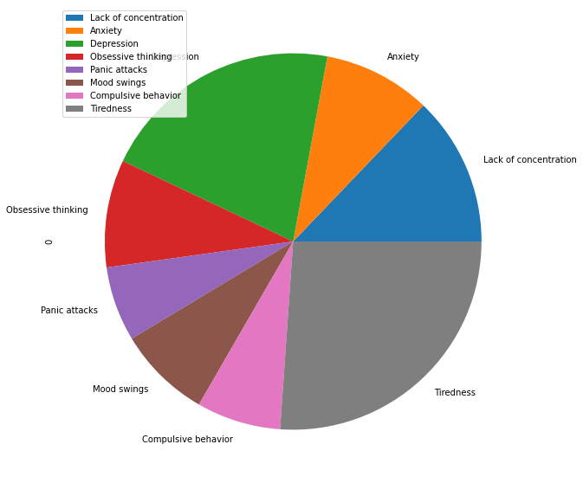
Survey results of the mental health illnesses accounted for that were Employed

Slide 9
Analysis
68% of those who participated in the study were employed at least part time
Majority of the people in this study who were employed fell under the categories of tiredness and depression
Higher numbers of unemployment were found in the following categories: Compulsive Behavior, Mood Swings, and Panic Attacks

Slide 10
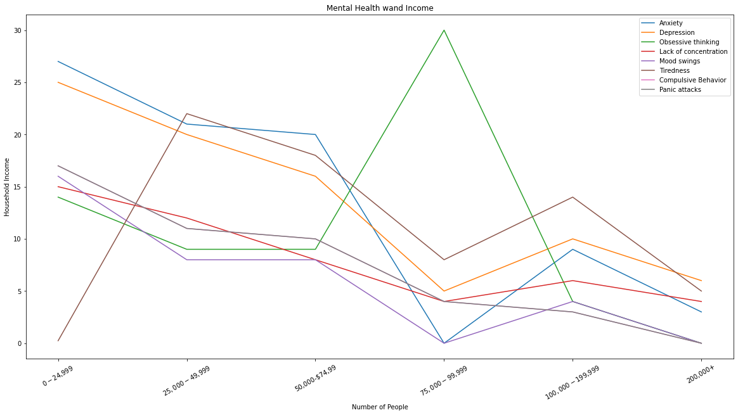
Income Trends by Mental Health Illness

Slide 11
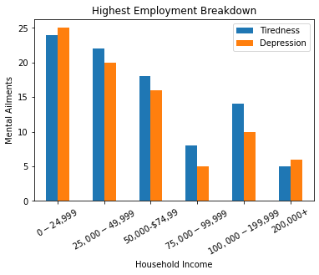
Highest Employment Breakdown of Income

Slide 12
Analysis
Overall within each mental illness we see income peak around $50k
Obsessive thinking peaks , with the most people in $75k to $99,999k
Mood Swings is consistently the lowest in each income group
Tiredness and Depression stay somewhat consistent with one another across each income level

Slide 13
Conclusion
In conclusion mental health was present in all completed education’s and incomes. However, we saw mental health was found in lesser quantities with people who have higher incomes.

Slide 14
Other Influences on Education, Employment, and Income not found in our dataset
Age range
Family structure
Types of jobs
Degree category
Geographic location

